Slide 1
Plant Cell Structures
Describe the structures of a typical plant cell and their functions
Compare and contrast animal and plant cells
Describe & diagram the process of mitosis
Describe & diagram the process of meiosis

Slide 2
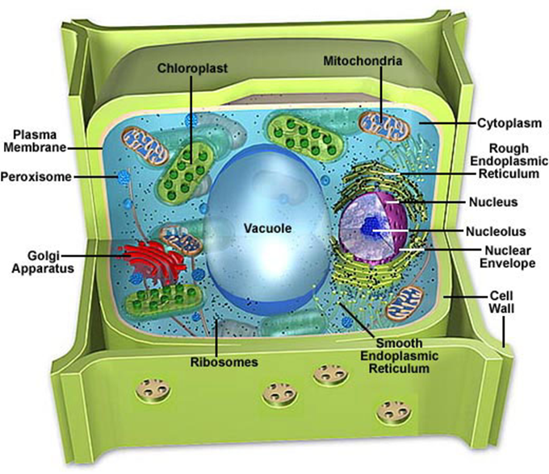
Plant Cell Structures
Describe the structures of a typical plant cell and their functions

Slide 3
Plant Cell Structures
Describe the structures of a typical plant cell and their functions
Cell Membrane
Allows substances in/out of cell
Cell Wall
Rigid structure only in plants that provides support and protection
Mitochondria
Transforms energy in cell “Powerhouse”
Golgi Apparatus
Sorts & packages proteins

Slide 4
Plant Cell Structures
Describe the structures of a typical plant cell and their functions
Lysosome
Digests & removes worn out organelles
Vacuole
Stores materials, very large in plant
Chloroplast
Captures light and conducts photosynthesis. Only in plants
Endoplasmic Reticulum
Site of chemical reactions. Has both “rough” and “smooth”

Slide 5
Plant Cell Structures
Describe the structures of a typical plant cell and their functions
Ribosomes
In the nucleus or cytoplasm. Site of protein assembly
Cytoplasm
Clear fluid that suspends organelles
Nucleus
Manages all cellular functions of cell
Nucleolus
Inside nucleus. Produces ribosomes

Slide 6
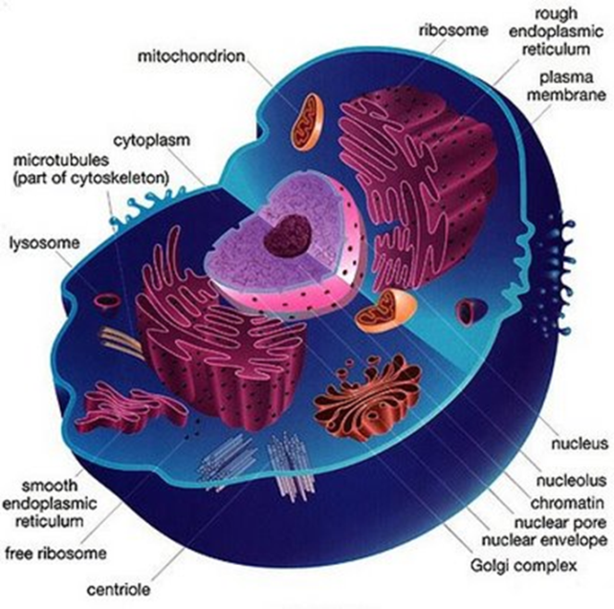
Animal vs Plant Cells
B. Compare and contrast animal and plant cells
No Cell Wall
Irregular shape
Has a cell wall
Fixed, rectangle shape

Slide 7
Animal vs Plant Cells
B. Compare and contrast animal and plant cells
Small Vacuole
Very large vacuole
Takes up 90% of cell volume

Slide 8
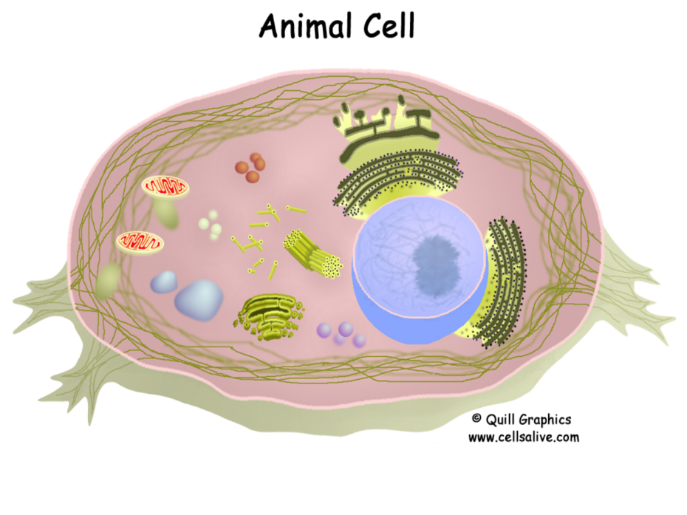
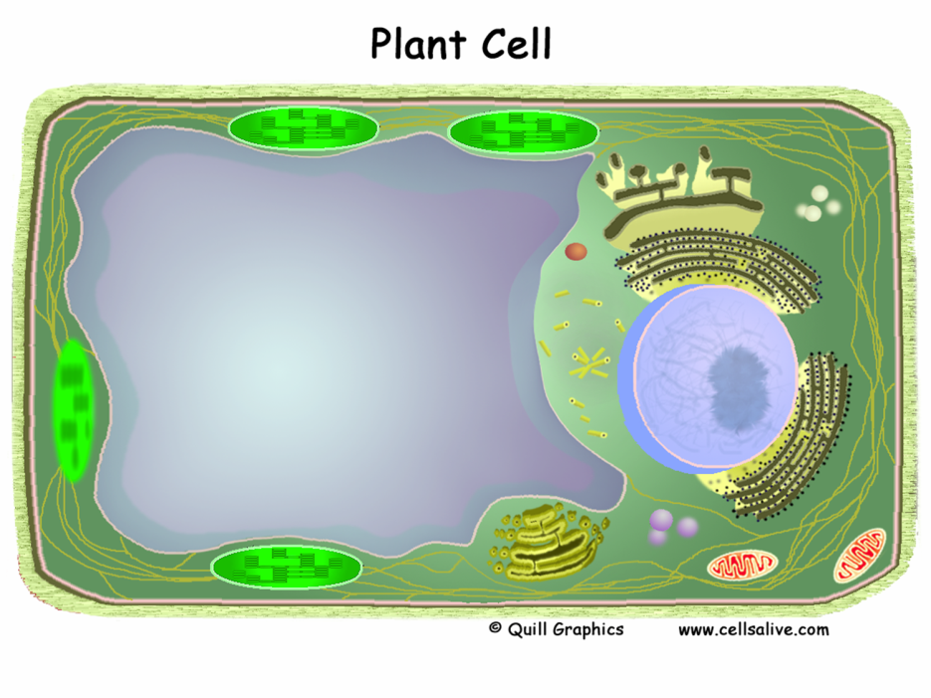
Animal vs Plant Cells
B. Compare and contrast animal and plant cells

Slide 9
Animal vs Plant Cells
B. Compare and contrast animal and plant cells
Has Centrioles
No Centrioles

Slide 10
Animal vs Plant Cells
B. Compare and contrast animal and plant cells
NO Chloroplasts
Chloroplasts
They make their own food (Producer)

Slide 11
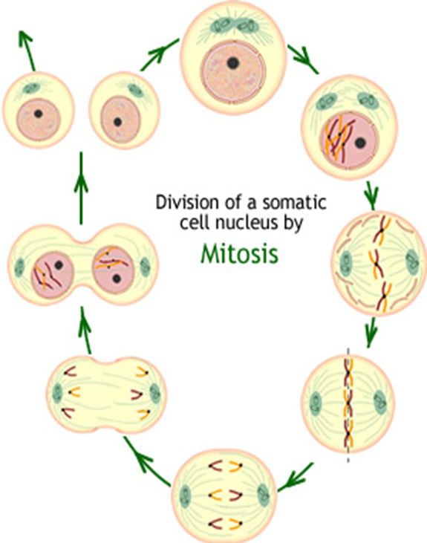
Mitosis
C. Describe & diagram the process of mitosis
Mitosis=
Cell Reproduction
Produces diploid cells
Necessary for
Growth
Repair

Slide 12
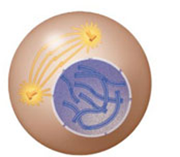
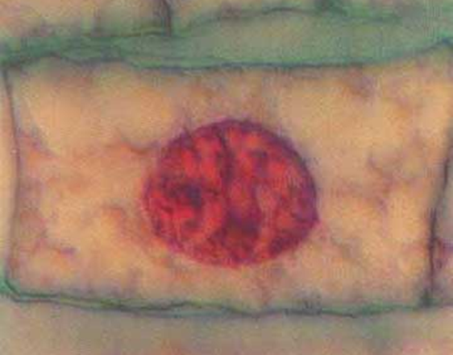
Mitosis
C. Describe & diagram the process of mitosis
Interphase=
Stage of growth before mitosis begins
Chromosomes are copied “Sister Chromatids”

Slide 13
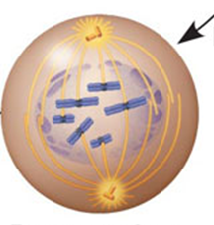
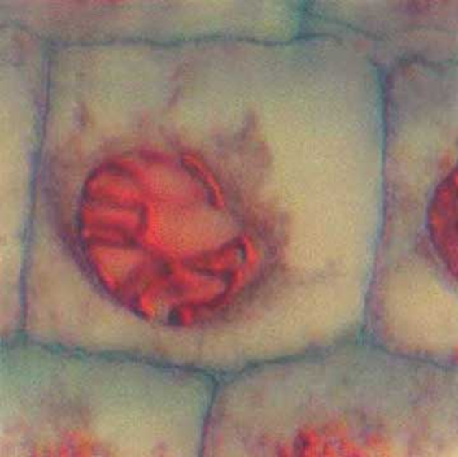
Mitosis
C. Describe & diagram the process of mitosis
Prophase=
Spindle fibers form between poles

Slide 14
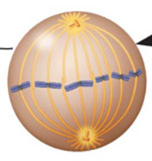
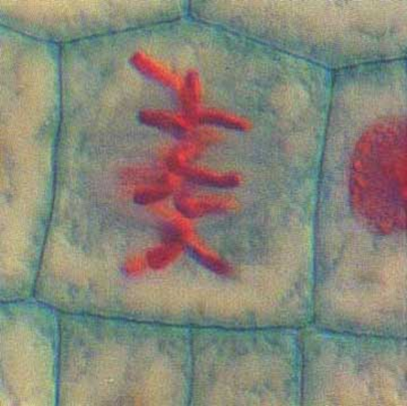
Mitosis
C. Describe & diagram the process of mitosis
Metaphase=
Chromatids attach to spindle fibers and line up in the middle

Slide 15
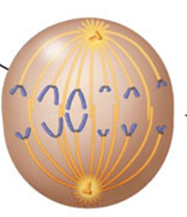
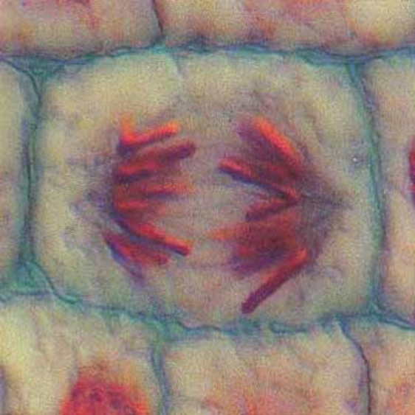
Mitosis
C. Describe & diagram the process of mitosis
Anaphase=
Chromatids pull apart and move to opposite ends of the cell

Slide 16
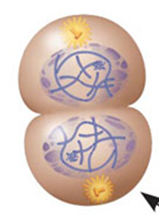
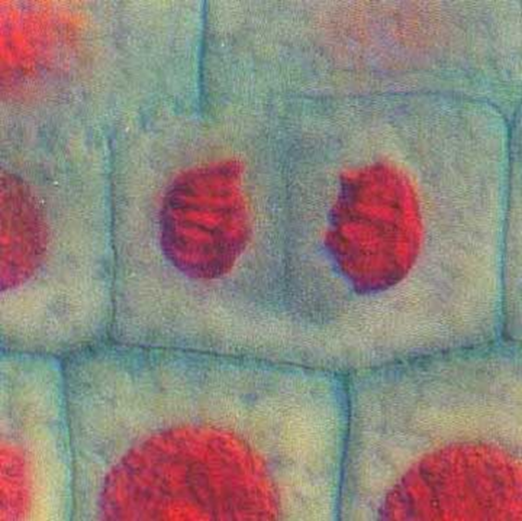
Mitosis
C. Describe & diagram the process of mitosis
Telophase=
Mitosis ends
Cytokinesis
Actual process of cell membranes pinching apart to create 2 cells

Slide 17
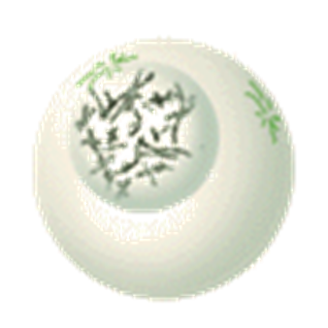
Meiosis
D. Describe & diagram the process of meiosis
Reproductive cell division
Reduces chromosome to haploid
Eight stages
Results in four genetically different cells

Slide 18
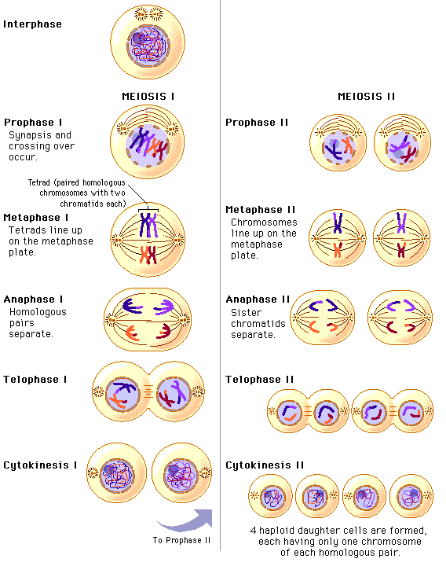
Meiosis
D. Describe & diagram the process of meiosis

Slide 19
Meiosis
Meiosis divided into two sections with a total of eight phases.
Meiosis 1
Meiosis II
These phases are continuous and flow one right after the other.

Slide 20
Bell Work 1/27:
Which organelle is stores water and nutrients and is very large in plant cells?
What is the function of the lysosome?
Which part of the cell makes ribosomes?

Slide 21
Bell Work 1/31:
This cellular organelle in plant cells is responsible for carrying out photosynthesis.
Which structure is a main difference between plant and animal cells? (It is made of cellulose.)
Which sorts and packages proteins?

Slide 22
Bell Work 2/2:
List 3 main differences between plant and animal cells.
How many cells are produced at the end of mitosis?
During which phase do the chromosomes line up in the middle of the cell?

Slide 23
Bell Work 2/6:
List the phases of the cell cycle in the correct order.
In which part of a plant would meiosis occur?
Which process does a cell with 46 chromosomes divide producing 4 cells with 23 chromosomes?

